Slide 1
Informed Searches
Instructor: Zainab Yousuf

Slide 2
Content
Informed Searches
Hill Climbing
Best First Search
Greedy Best First Search
A* Search

Slide 3
Informed Search
Search that take place on the basis of some hints/ heuristics.
It is also known as Heuristic Based Search
In order to search on the basis of some heuristic, we must have estimated heuristic values to certain desired level (not necessarily from the root node and similarly not till the leaf nodes)

Slide 4
Hill Climbing
Hill Climbing is basically a depth first search with a measure of quality (cost/heuristic) that is assigned to each node in the tree.
The basic idea is to traverse in DFS manner except that you order your choices according to some heuristic measurement of the remaining distance to the goal.

Slide 5
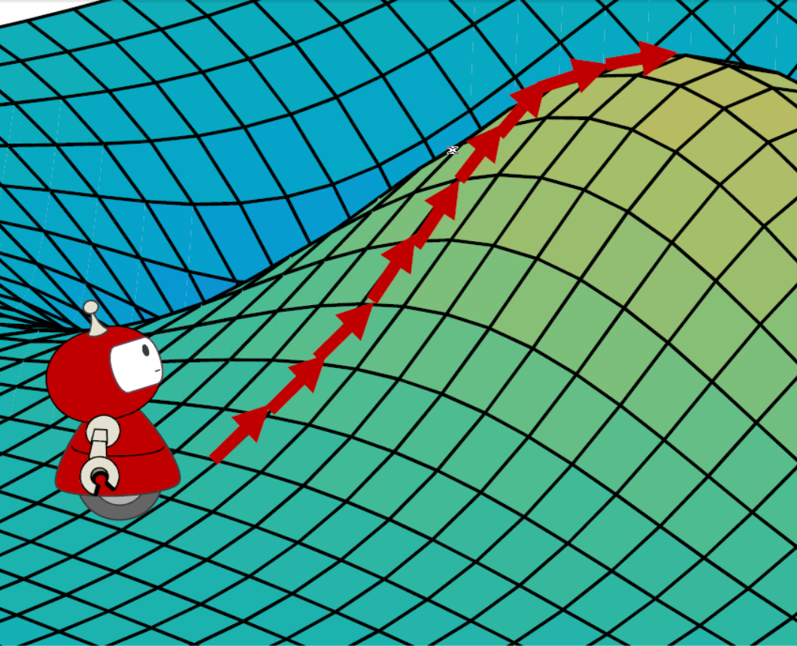
Hill Climbing
Lets discuss an analogy for which the name Hill Climbing has been given to this procedure.
Consider a blind person climbing a hill. He can not see the peak of the hill. The best he can do is that from a given point he takes steps in all possible directions and wherever he finds that a step takes him higher he takes that step and reaches a new, higher point. He goes on doing this until all possible steps in any direction will take him higher and this would be the peak, hence the name hill climbing. Notice that each step that we take, gets us closer to our goal which in this example is the peak of a hill.
Such a procedure might as well have some
problems.

Slide 6
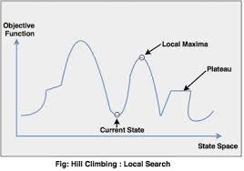
Problems of Hill Climbing
Foothill Problem: Before reaching the global maxima, that is the highest peak, the blind man may encounter local maxima that are the intermediate peaks and before reaching the maximum height.
At each of these local maxima, the blind man gets the perception of having reached the global maxima as none of the steps takes him to a higher point.
Hence he might just reach local maxima and think that he has reached the global maxima. Thus getting stuck in the middle of searching the solution space.

Slide 7
Problems of Hill Climbing
Plateau Problem: Similarly, consider another problem as depicted in the diagram below. Mountains where flat areas called plateaus are frequently encountered the blind person might again get stuck. When he reaches the portion of a mountain which is totally flat, whatever step he takes gives him no improvement in height hence he gets stuck.

Slide 8
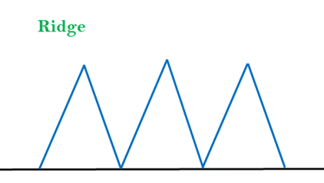
Problems of Hill Climbing
Ridges: A ridge is a special form of the local maximum. It has an area which is higher than its surrounding areas, but itself has a slope, and cannot be reached in a single move.

Slide 9
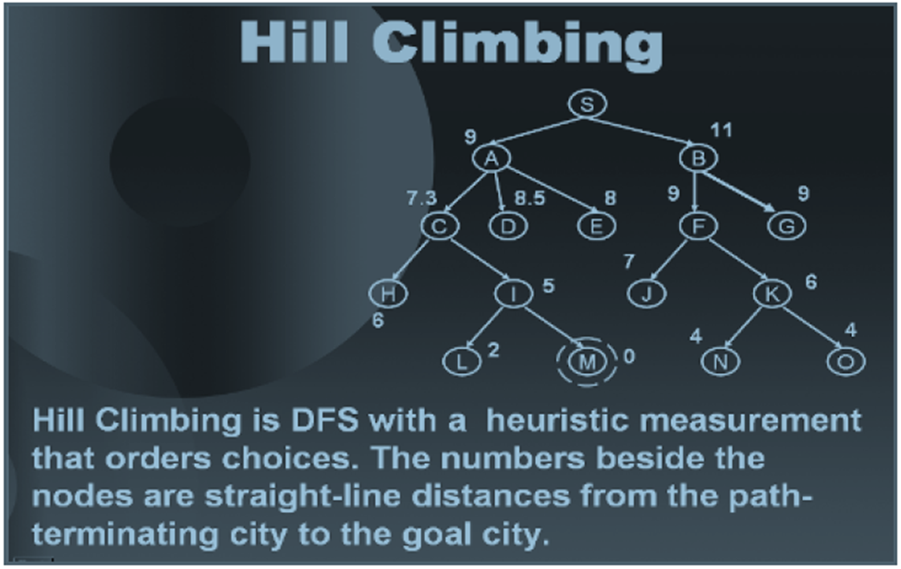
Hill Climbing Algorithm Example

Slide 10
Hill Climbing Algorithm Example- Plateau
8

Slide 11
Hill Climbing Algorithm Example- Local Minima
8
2

Slide 12
Hill Climbing Algorithm Example- Ridges
8
2
2

Slide 13
Assignment # 3
Types of Hill Climbing Algorithm:
Simple hill Climbing
Steepest-Ascent hill-climbing
Stochastic hill Climbing

Slide 14
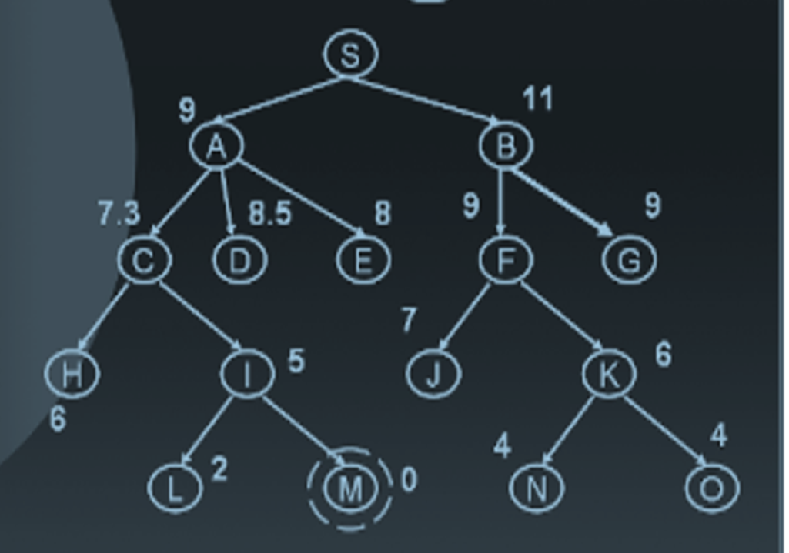
Best-First Search
The best first search considers all the open nodes so far and selects the best amongst them. The following sequence of diagrams will show you how a best first search procedure works in a search tree.
From S we observe that A is the best option so we explore A.
At A we now have C, E, D and B as the options. We select the best of them which is C.
At C we have B, D, E, H and Ias the options. We select I which is the best of them.
At last from I we find M as the best.

Slide 15
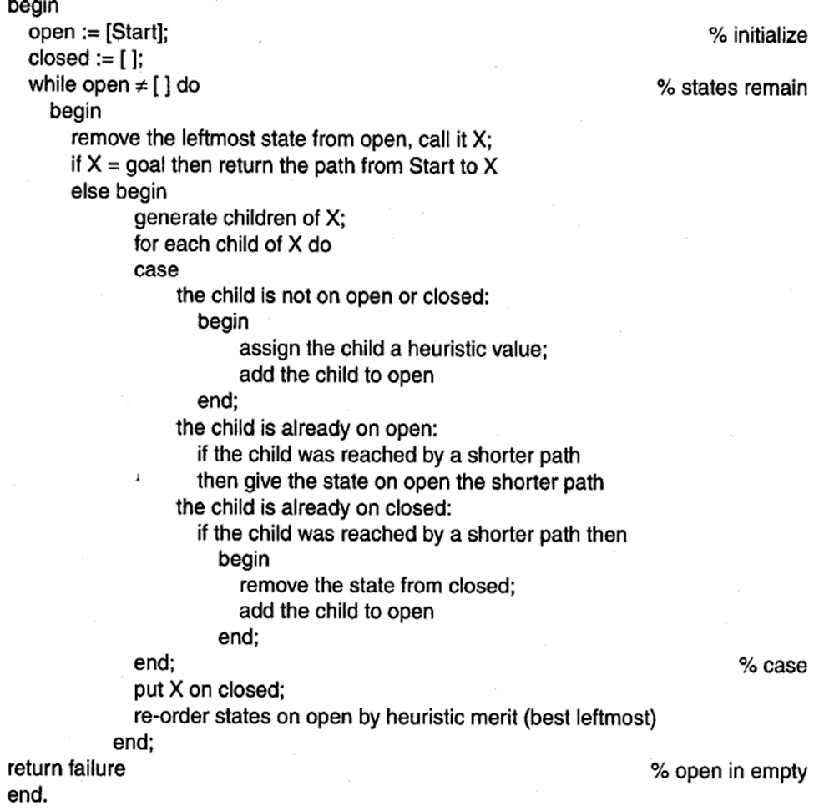
Best-First Search

Slide 16
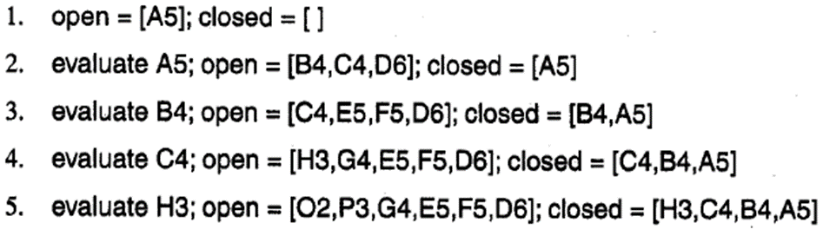
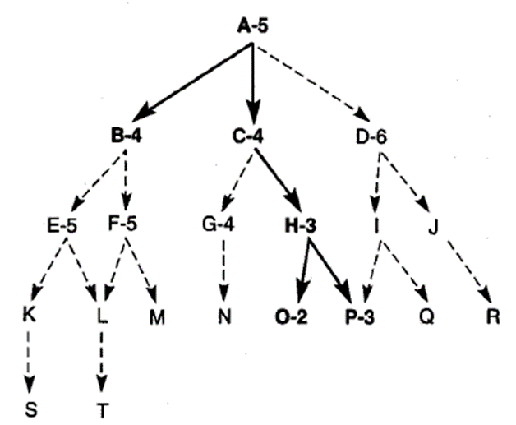
Best-First Search

Slide 17
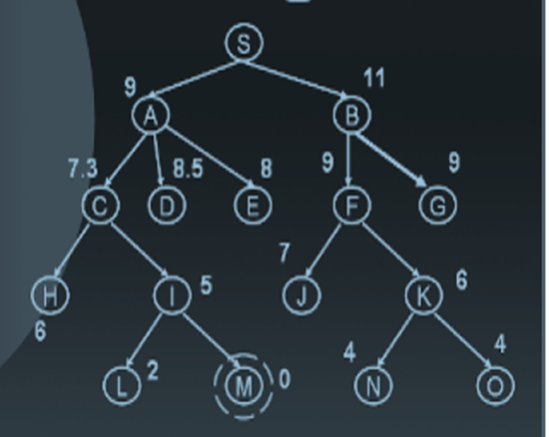
Sr. # | X | Open | Close
1. |  | [S] | []
2.

Slide 18
Best-First Search - Example
A5
B4
C4
D5
E6
F5/3/2
G8
H8
K5
N6/6
M7
O9
Q9
P0

Slide 19
These Best-First search algorithm has two version; Greedy best-first search and A*. In both versions, the algorithm remains same while heuristic is evaluated with different factors. Greedy search works only on h(n), heuristic discussed so far, while A* works on F(n)=g(n) + h(n).

Slide 20
A* Search
Heuristics are fallible, it can mislead.
If two states having same heuristics value at some middle phase, it does not mean that both will provide you the shortest path.
Whenever such situation occur it is better to examine the state that is nearest to the root state of the graph.
Among the two state having same heuristic, the state whose distance is shorter from start state will have a greater probability of being on the shortest path to the goal.

Slide 21
Heuristic Evaluation for A*
The distance from root can be measured by maintaining a depth count for each state. BY accommodating this information our heuristic function will become as
f(n)= g(n)+h(n)
The g(n) measure the distance from any state ‘n’ to start state.
The h(n) is a heuristic estimate of the distance from state n to a goal.
After assigning heuristics value we can apply best-first algorithm to search for a goal.

Slide 22
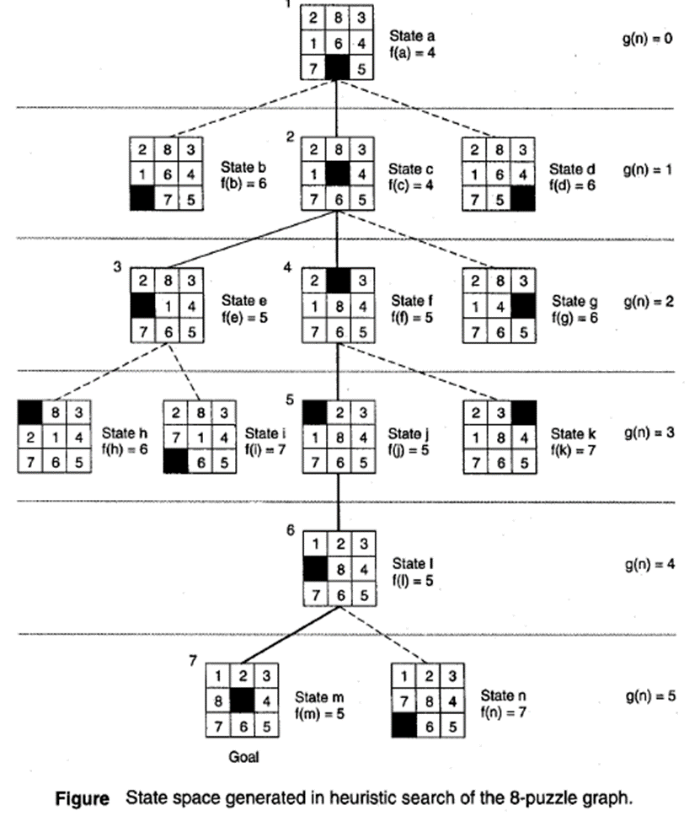
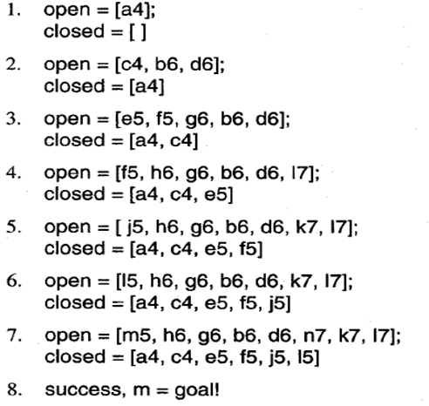
A* Example

Slide 23
Best-First Search
Hence best first search is a greedy approach will looks for the best amongst the available options and hence can sometimes reduce the searching time.
All these heuristically informed procedures are considered better but they do not guarantee the optimal solution, as they are dependent on the quality of heuristic being used.

Slide 24
Thank You

